Slide 1
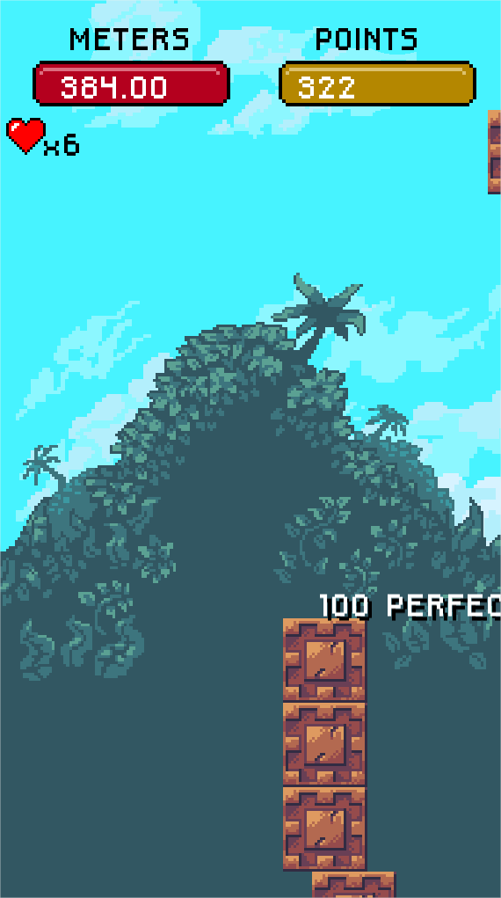
Omnidrone tech test
Alberto Milá Díaz

Slide 2
Packages
Game configuration
Game screens
Game states
Specific game components
Main game loop
Main window
Main renderer
Serialization system
Entity component system
Ui system
State system
Core helpers
SFML: graphic library
PugiXml: xml handler

Slide 3
Pipeline
GameTimer limits to 60pfs.
StateManager has all the game states.
Render happens at the very end.
There are two render layers, the World and the UI. The World layer is rendered first and then the UI layer.

Slide 4
Serialization
Serialization uses pugixml to save and load data.
Is used by:
Screens
Game Objects
AppConfig
GameConfig
GameSaveData

Slide 5
Settings
Settings is a singleton that contains some modules that we want quick access from any part of the game.
Game status contains the status of the gameplay, points, remaining lives, etc..

Slide 6
Entity component system
Classic pattern of an entity component system.
Example: an UI button has CButtonComponent, CSpriteComponent and CTextComponent.

Slide 7
State manager
State manager has all the states of the game registered.
The sate requests the next state depending on game actions.
Usually a state has the UI screen to display elements.

Slide 8
Screen system
Screen system.
A screen loads all the data from a file using a serialization ScreenDescriptor.
All the game screens derive from CScreenBase that has all the GameObjects.
Usually a screen is inside a game state.

Slide 9
Spawning tower block
Two spawing areas, left and right
When spawned it sets a random angle, position and speed.
Oscillation of the tower is linked with the current progression. The taller the difficult.

Slide 10
What’s next, what is missing
Animation system.
Integrate component system into serialization module.
Sounds.
Improve gameplay physics.
Localization system, integrate it into serialization module.

Slide 11
Cheats
You can modify the lives by changing the value “lives” in “data/GameConfig.xml”
You can modify the rankings by modifying the file “data/SaveData.xml”

